Slide 1
“Blood Bank Management System”
Presented by :-
1. AKSHAY GAJANAN MANKAR Roll No:- 1010
2. VIKAS ANKUSH YEDAVE Roll No:- 1242

Slide 2
Features:- 1)Admin: -Manage the Registration of users, donors, and organization. -View User/Donor and organization information. -Check the available blood stocks. 2)User: -Check the blood availability. -Register -login -Post the blood buy request 3)Donor: -Register -login -Donate blood according to the slots available.

Slide 3
1)Availability- -Users & Donors can access this management system from anywhere from this web application. 2)Security: -Users and Donors information should be kept confidential under security system by Admin. -The system has encrypted password which can be seen in database. 3)Reliability: -System will be reliable enough to provide intact information about to user and donor. -Once the blood is donated or request for blood is post user or donor will receive the notification on the same. 4) Performance: -Basic system configuration is enough to access the web application. -Users and Donors can access the web application from mobile phones with minimal performance of the same. -Performance of the system remains same regardless of platform either it is laptop or mobile phone.

Slide 4
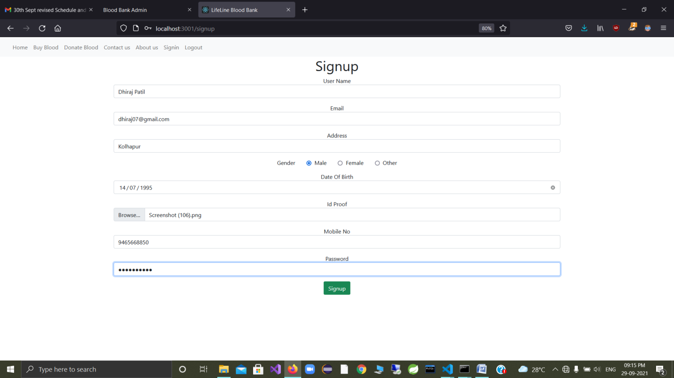
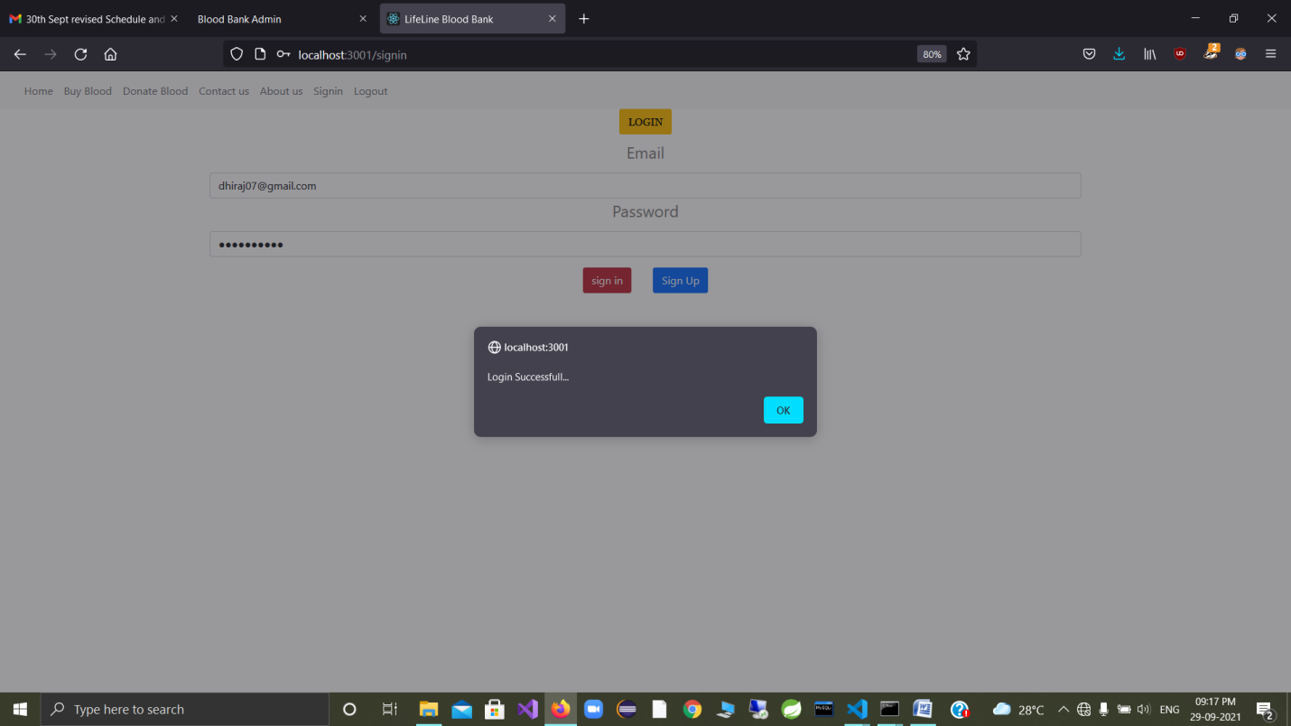
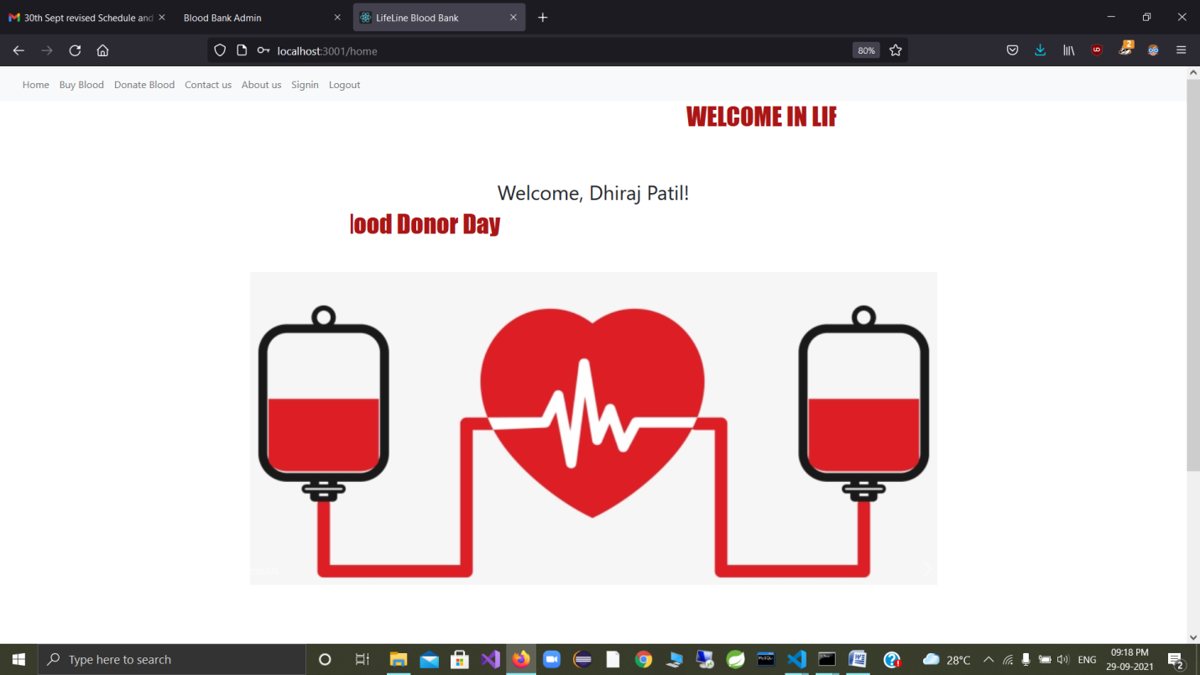
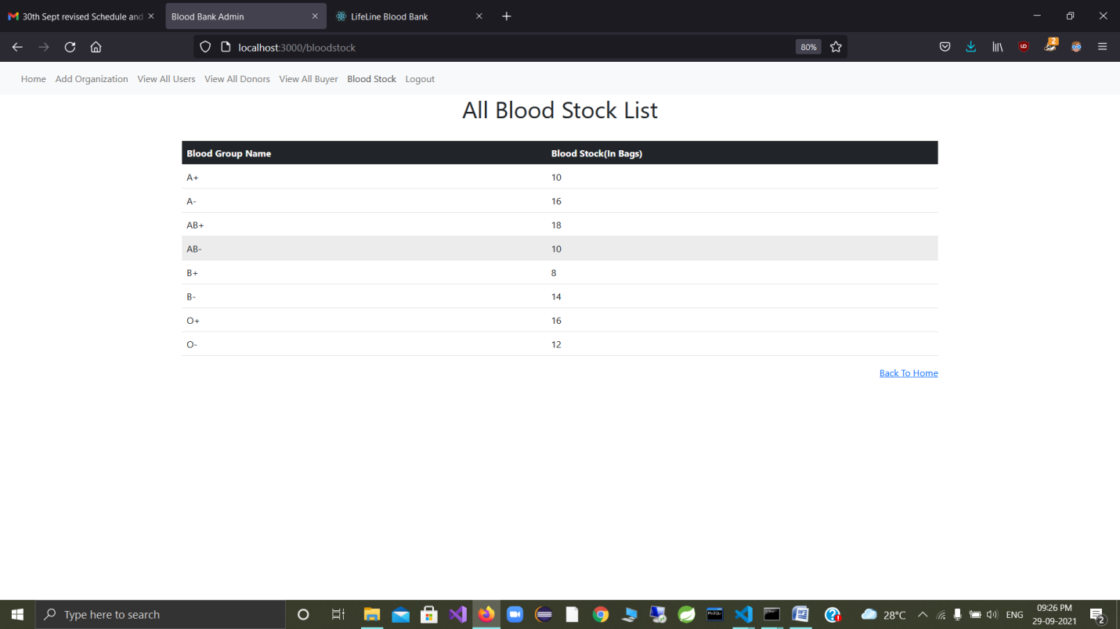
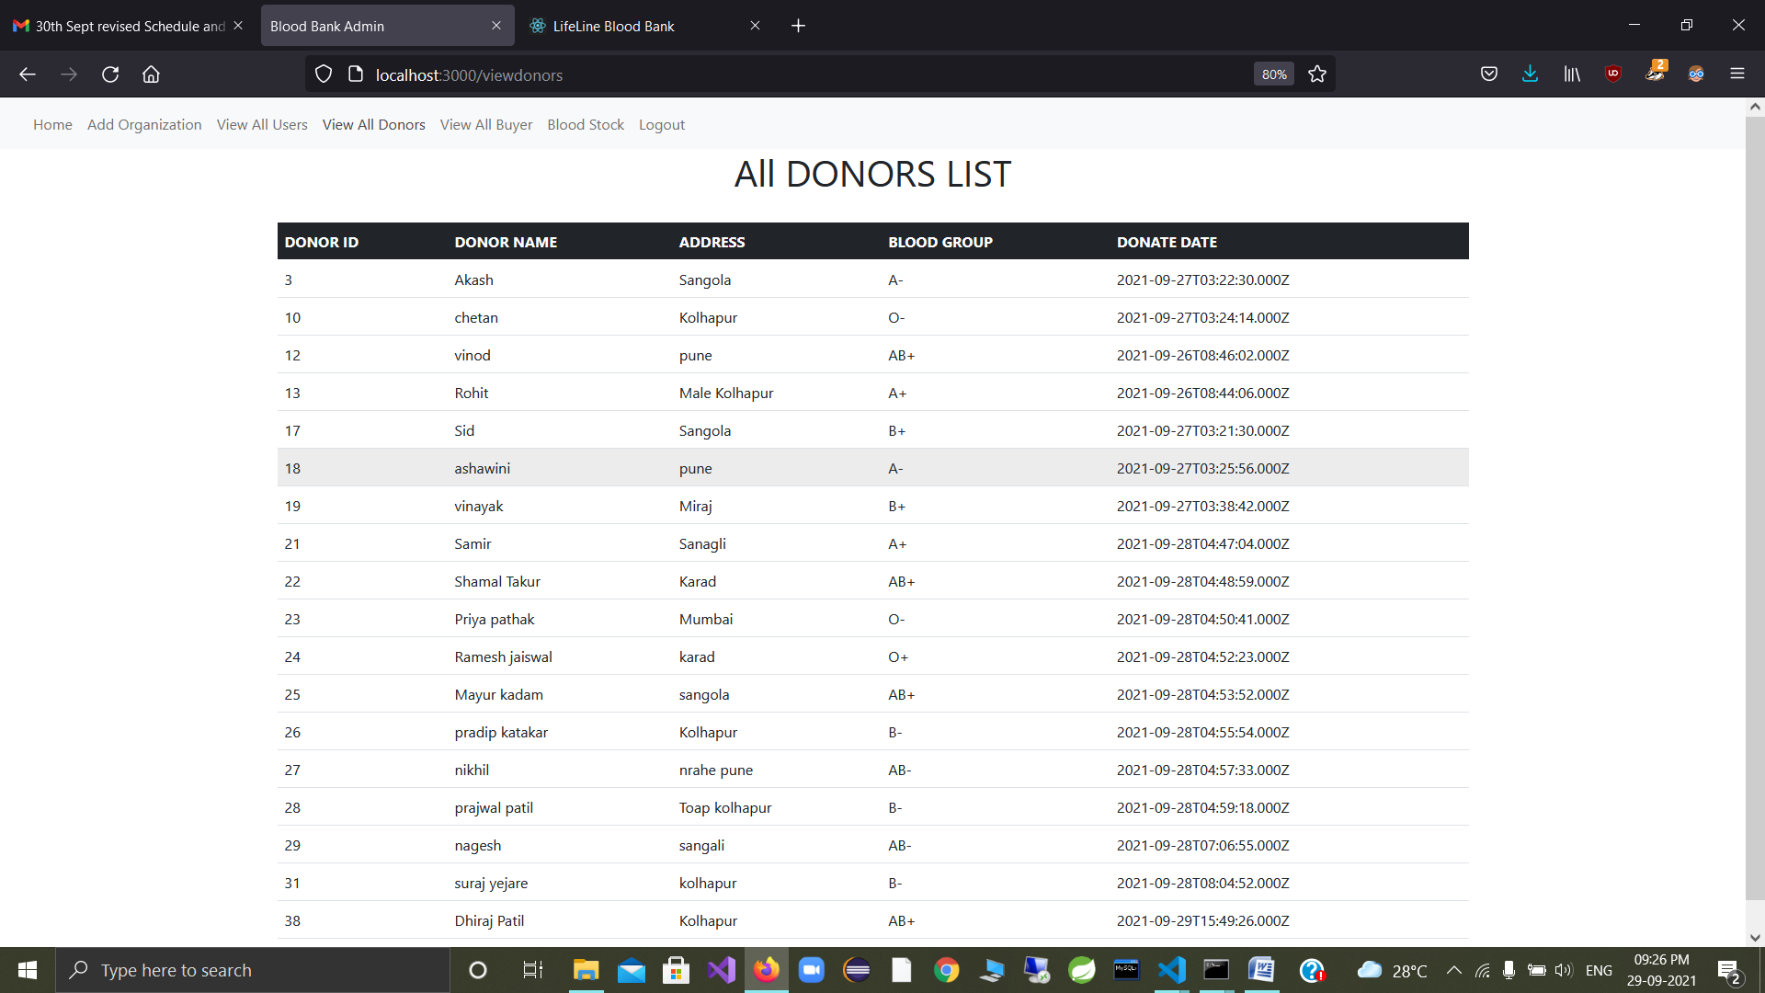
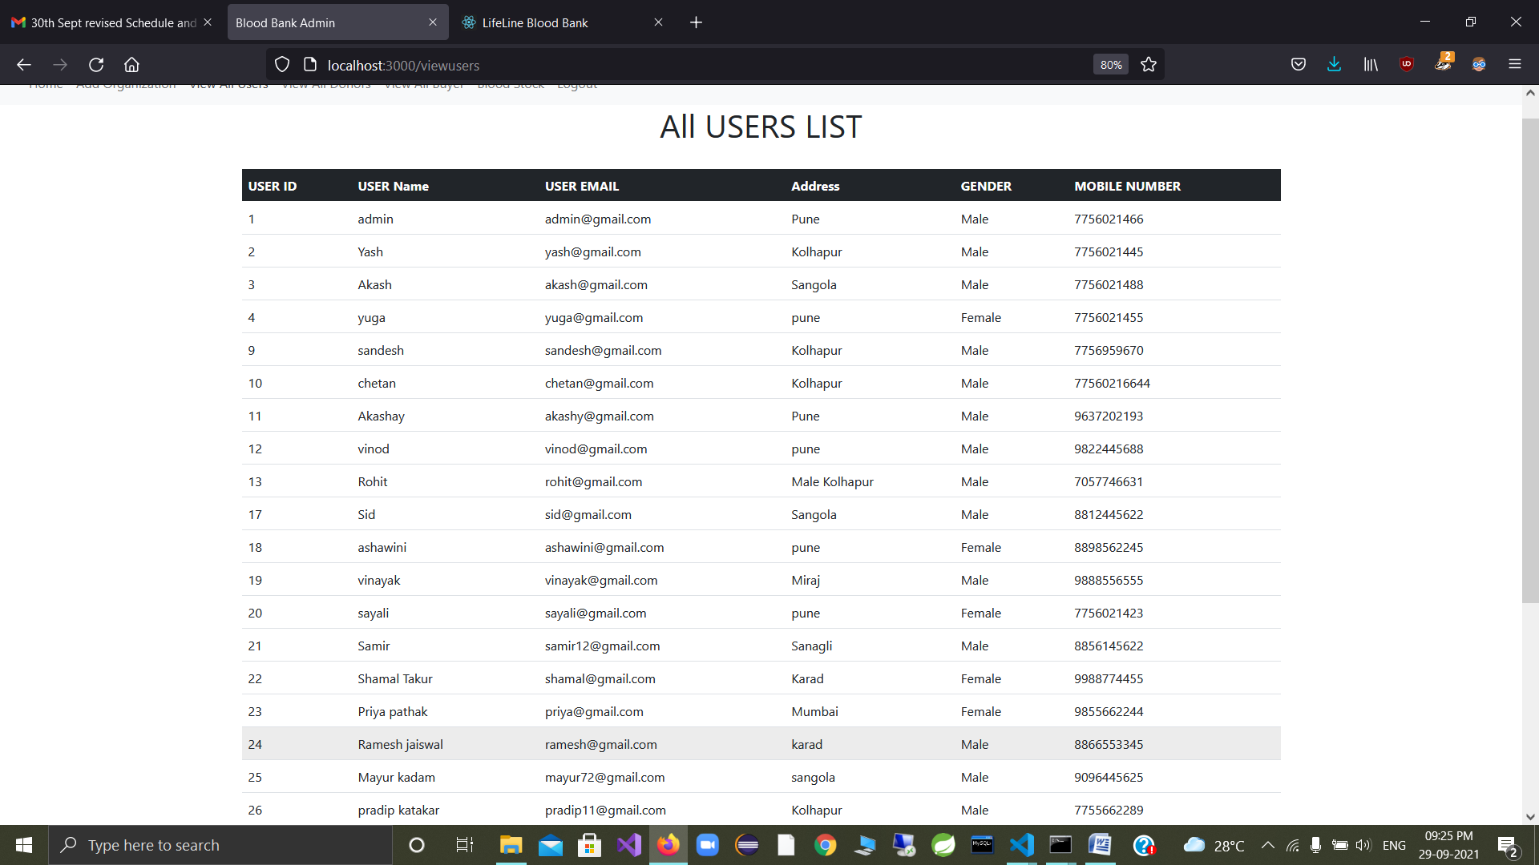
Screenshots of Project:-

Slide 5
Conclusion:- Using this project “Blood Bank Management System” people can search blood group available which they need. They check the details using blood bank management website. The main benefit of this system is the information of available blood group. This will save the time and eventually help to save the life of a person who is in extreme need of the blood in an emergency. This website works 24*7 so user can get information of blood required at any time.

